Slide 1



an innovative approach to inform equitable growth Dr. Aaron Schroeder Social Decision Analytics Division (SDAD) of the UVA Biocomplexity Institute
Mid-Atlantic Statistics Network (MASN) “Data Re-Use in Action” 2022-05-06

Slide 2
Me
Aaron Schroeder, PhD Research Associate Professor and Data Scientist, Social Decision Analytics Division (SDAD) of the UVA Biocomplexity Institute
Overarching research focus is the enablement of Evidence-Based Policy-Making and Program Evaluation through the Secure Liberation, Integration and Analysis of All Available Data
Background is Public Policy & Public Administration, long-term research focus on Data
Learned early-on that “good” policy and program-level decision-making relies on good data, but that many times the data was inaccessible, was unusable in its current state, or simply didn’t exist
Have spent much of my career trying to address these very issues
Creating the privacy-protected probabilistic linking mechanism to federate data between multiple state agencies for the Virginia Longitudinal Data System (VLDS)
Integrating all available traffic incident, construction, and travel data into a singular access point, 511 Virginia
Creating a data collection system, the Virginia Early Childhood Professional Registry, to collect policy-relevant credential data not previously collected
Lead our Research Infrastructure, Data & Development Team
Overall Responsibility for Software Development and the Scientific Computing Infrastructure at SDAD
Co-director of the Data Science for Public Good (DSPG) Young Scholars Program
immersive summer data science program for undergraduate and graduate students from across the country
Principal Investigator on many social-good-oriented data integration projects, including today’s focus project, the Social Impact Data Commons

Slide 3
SOCIAL IMPACT DATA COMMONS
Agenda
PROJECT VISION
PROJECT TIMELINE
PROJECT APPROACH
AN EXAMPLE FOLLOWING APPROACH FOR BROADBAND EQUITY
OTHER EXAMPLES (VERY BRIEFLY)
ARCHITECTURE

Slide 4
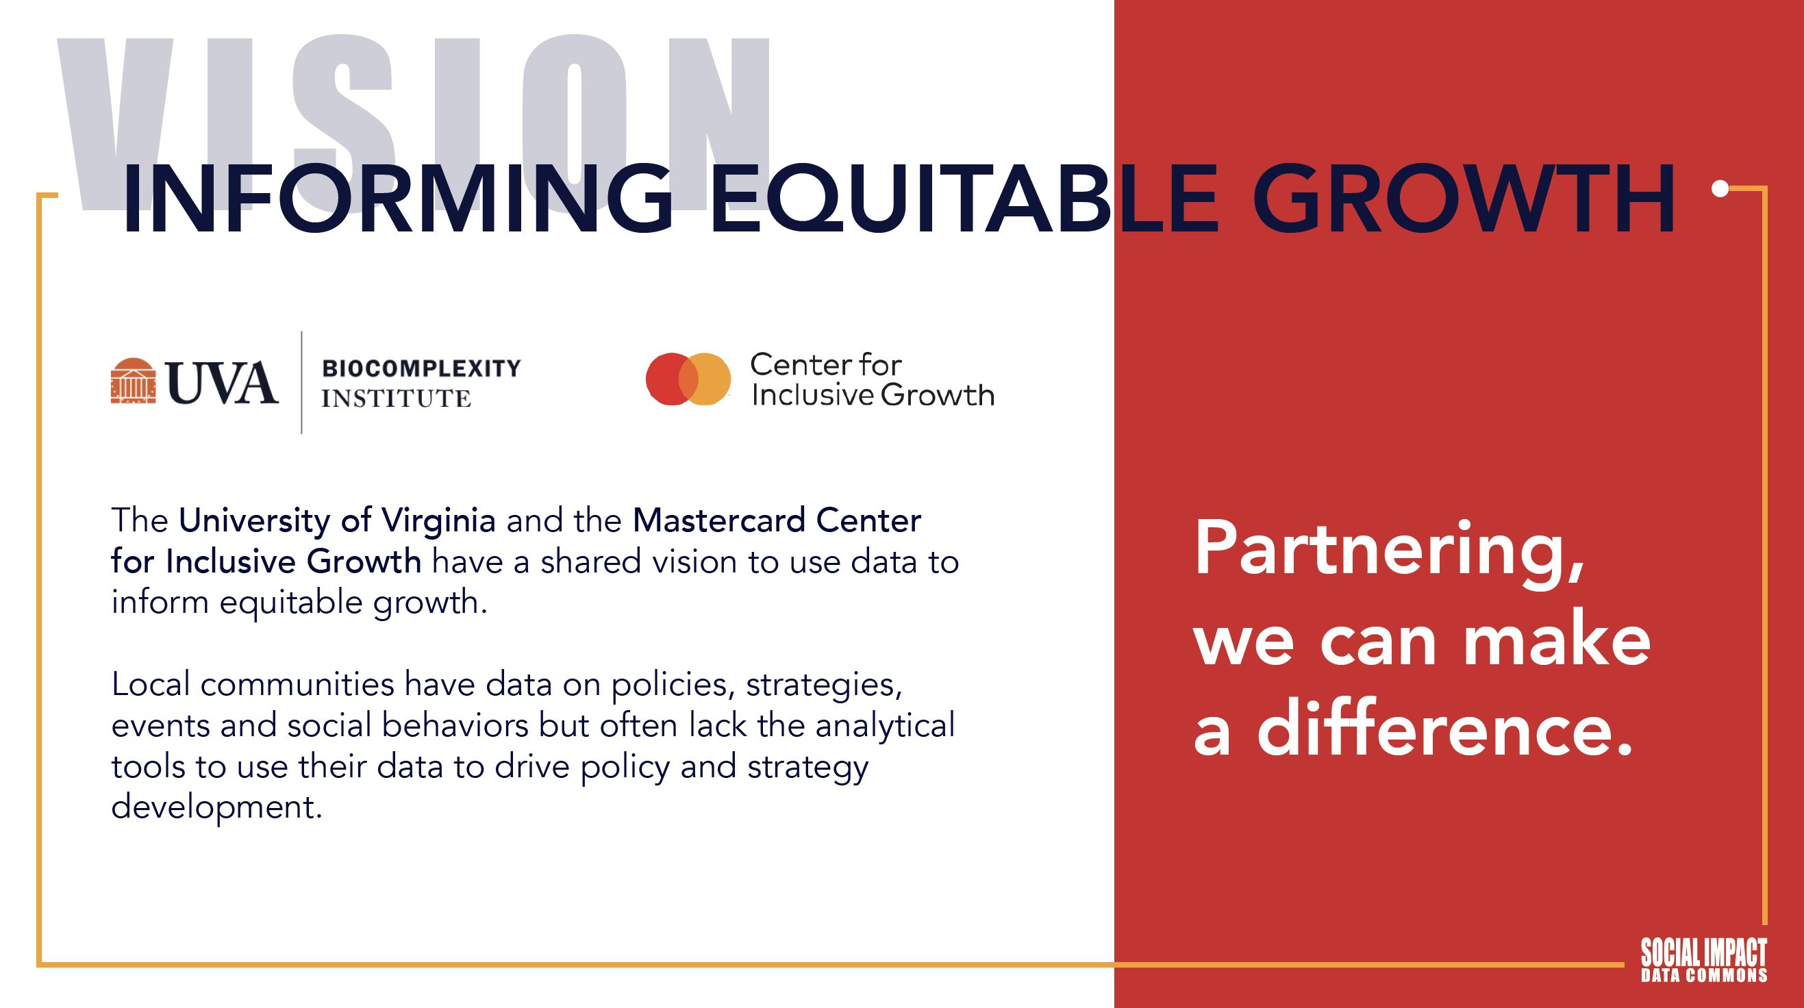

Slide 5
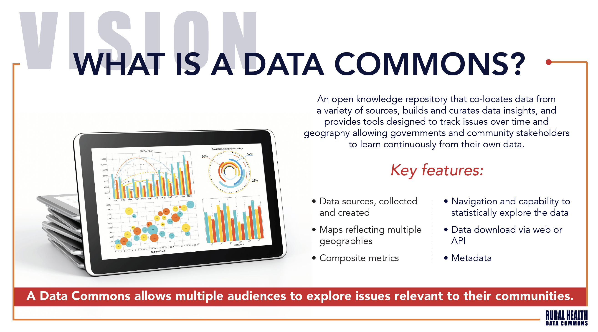

Slide 6
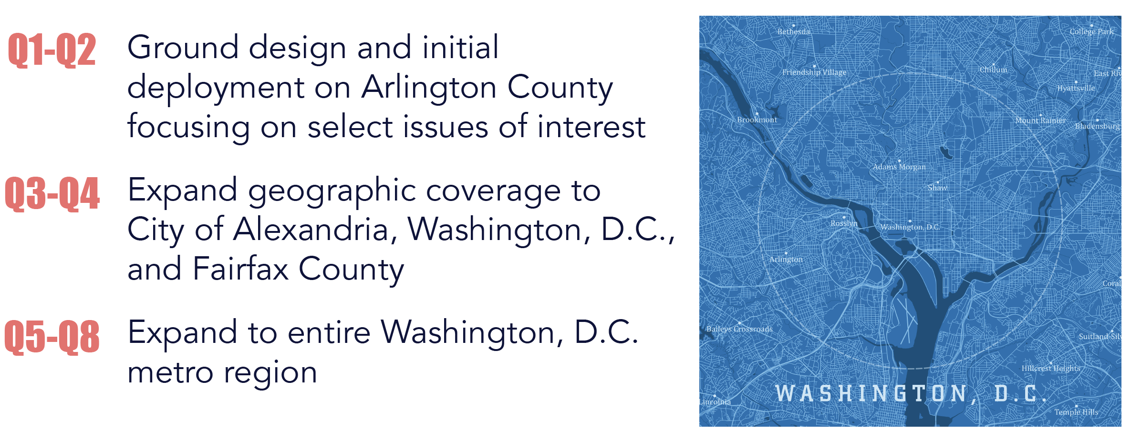
PROJECT TIMELINE
Project Phases

Slide 7
PROJECT APPROACH
Initial Grounding in Specific Local Issues
To kickoff the project, the team worked in partnership with key Arlington County agency personnel, driven by the tireless efforts of CDO Jaime Lees, to identify several local social impact issues
These issues were selected on the basis that they can immediately benefit from the provision of new data and metrics and serve as powerful exemplars to showcase the impact and values of the Social Impact Data Commons as the project expands
Initial Issues:
Equity of Broadband Access
Equity and Stability of Access to Staple Foods
“Other-Than Census” Geographies for Equity Analysis

Slide 8
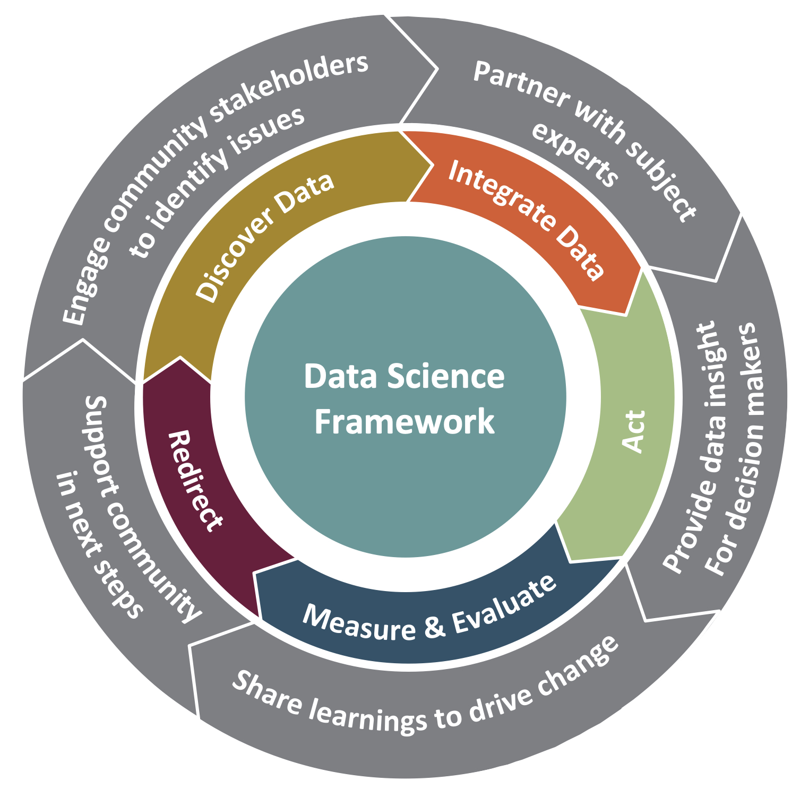
PROJECT APPROACH
Iterative Process with Decision Makers Getting to Required Data & Metrics
Community Learning Through Data Driven Discovery (CLD3)
CLD3 goes beyond traditional organizing aspects of collective action programs and supports communities in building capacity for data-informed decision making.
Outer wheel: continuous interaction and communication across stakeholders
Middle wheel: data-driven learning process
Frontier: between the outer and middle wheels is active collaboration between all partners
Inner circle: rigorous research framework to guide the data science

Slide 9
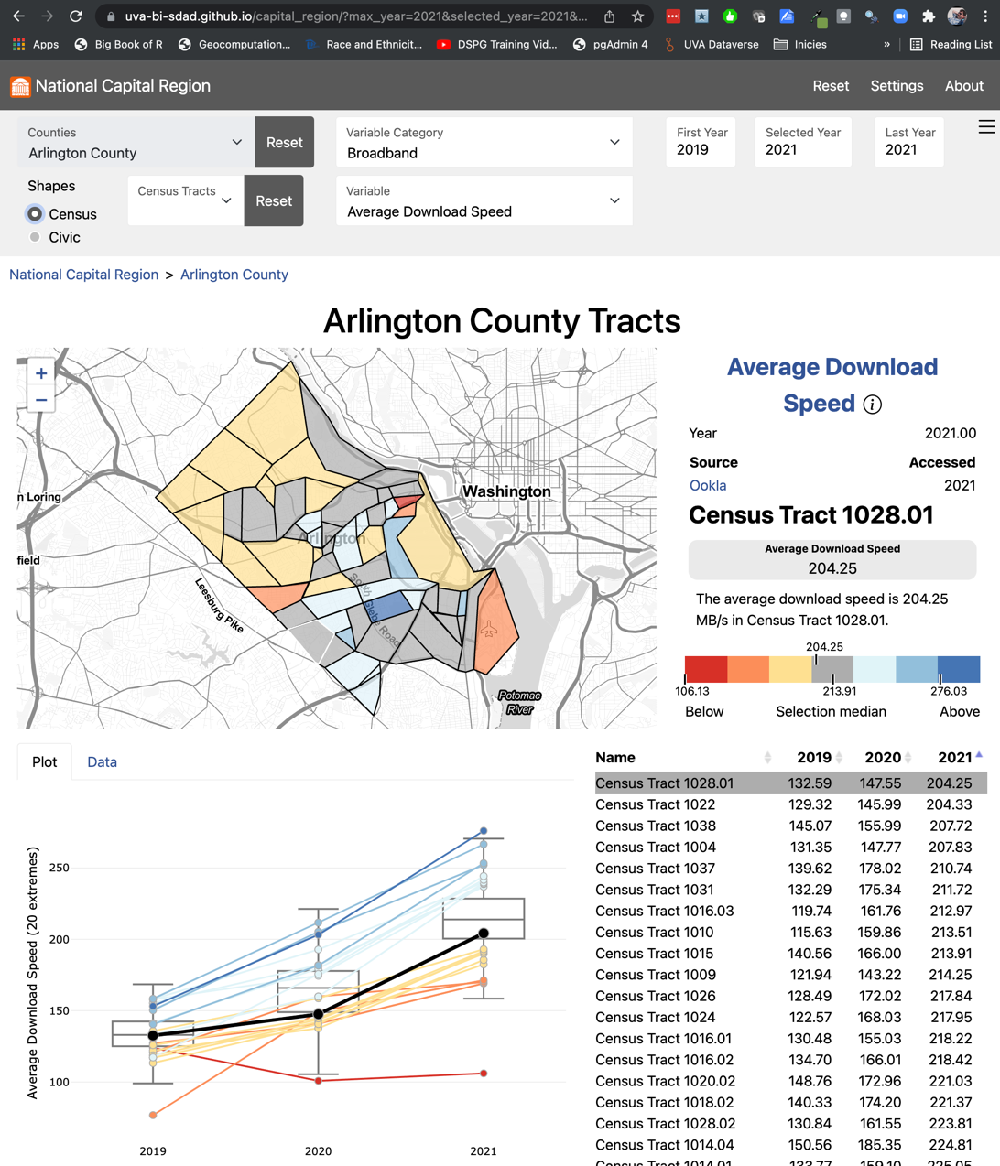
EQUITY OF ACCESS TO BROADBAND
Multiple Measures to Tell the Story
Average download speeds (from Ookla) are relatively high across Arlington with the slowest average still above 100Mb (the newer standard for “broadband”)
Ookla data only recently made available in 600-meter squares that we translated to block groups

Slide 10
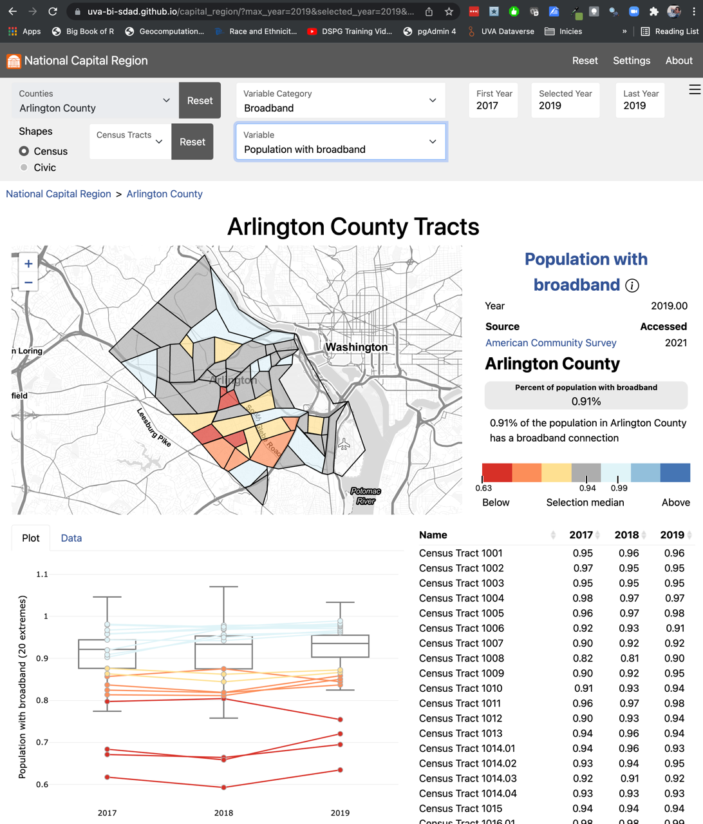
EQUITY OF ACCESS TO BROADBAND
Multiple Measures to Tell the Story
However, specific areas can be identified that have a significantly lower level of broadband adoption the the rest of Arlington

Slide 11
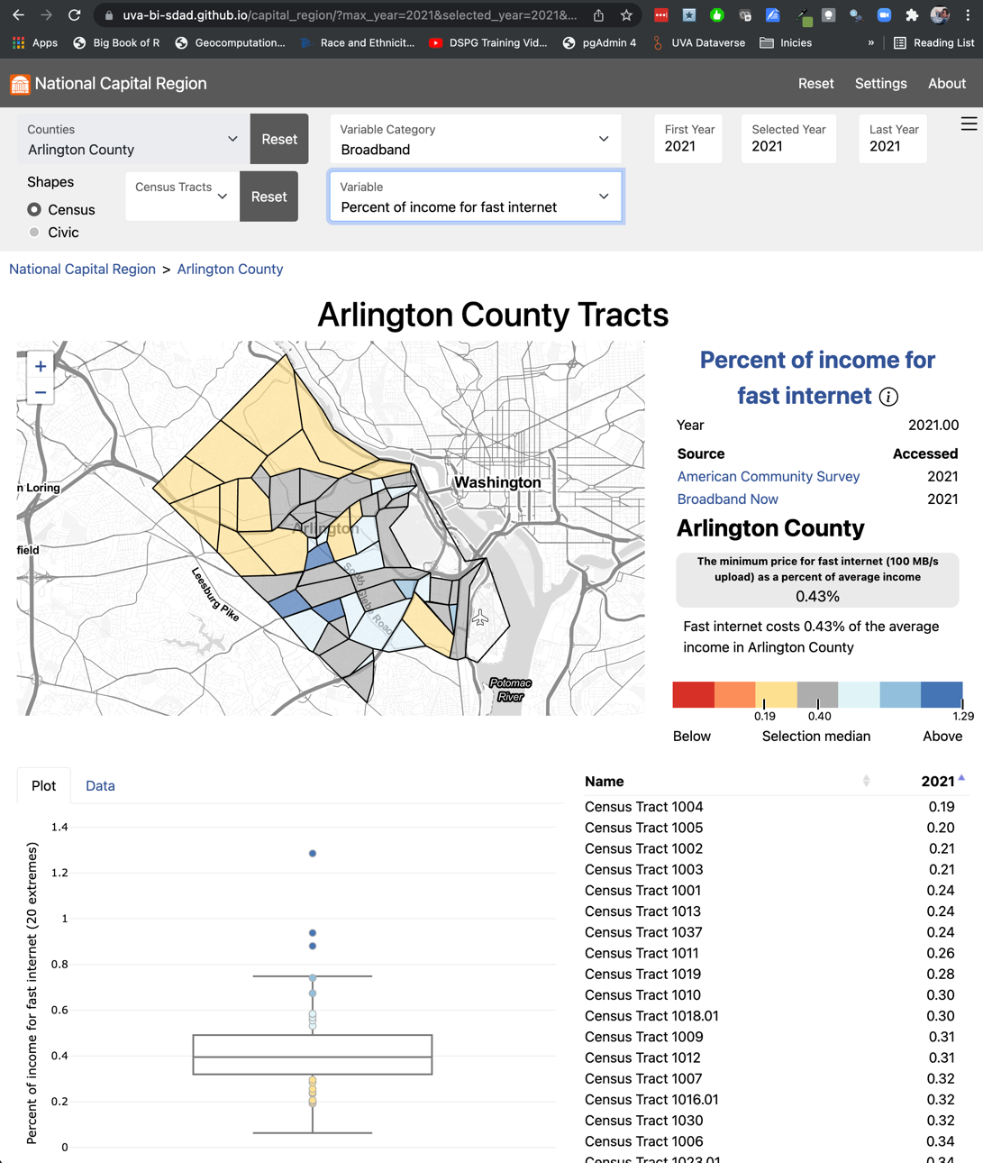
EQUITY OF ACCESS TO BROADBAND
Multiple Measures to Tell the Story
Calculated % or household income vs cost of 100Mb/s in every block group
These areas of lowest broadband adoption appear to directly correlate with the areas having the highest ratio of household income to the cost of broadband, indicating an economic issue, as opposed to an issue of availability.

Slide 12
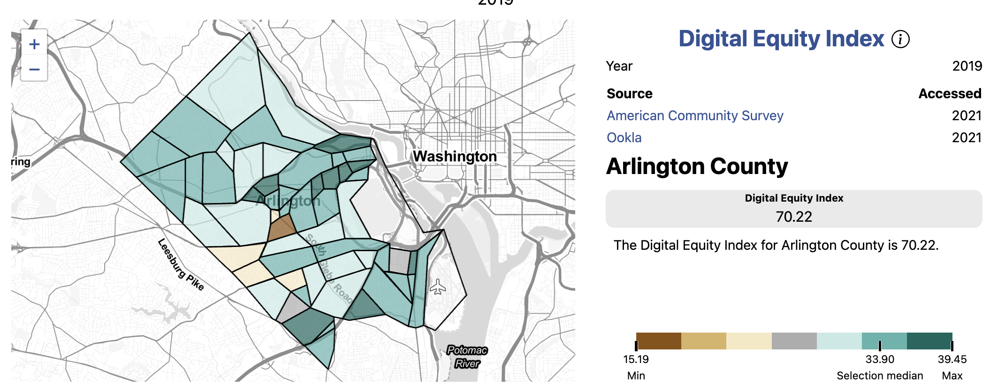
EQUITY OF ACCESS TO BROADBAND
The Digital Equity Index (DEI) Combine these with other socio-economic variables to create completely new metric
1
2
3
4

Slide 13
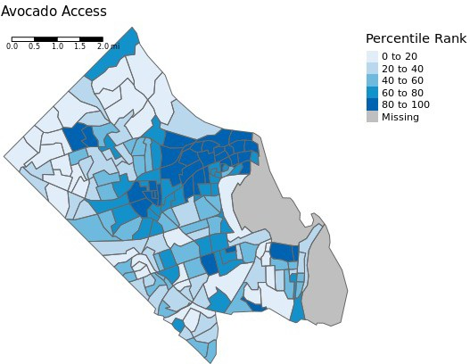
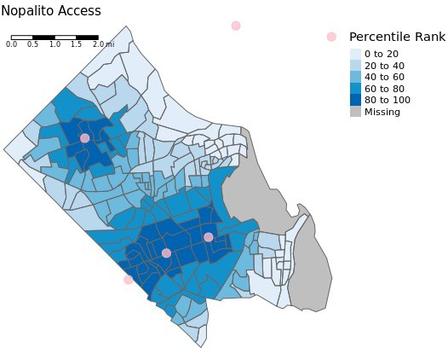
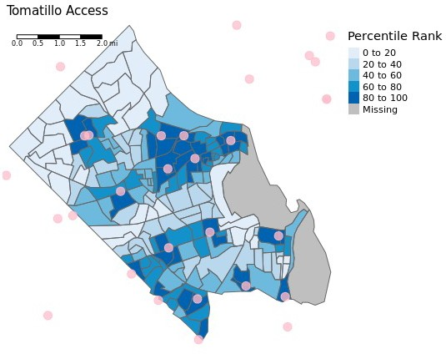
EQUITY & STABILITY OF STAPLE FOODS ACCESS
Relative access to individual food items using a gravity index Items can be combined to create culture-specific food baskets

Slide 14
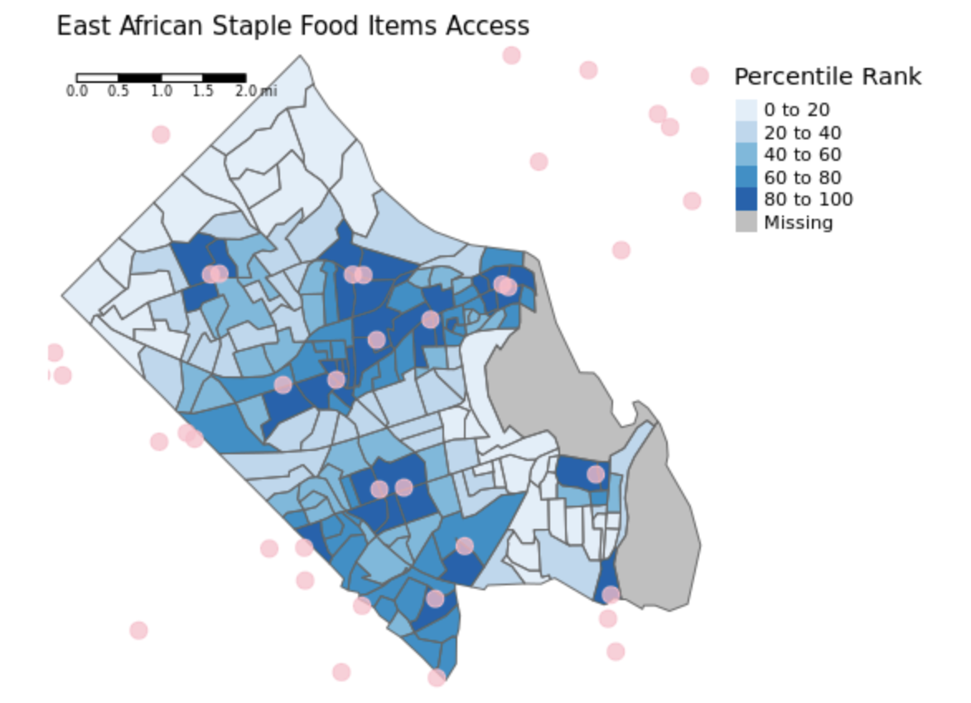
Equity & Stability of Staple Foods Access
Relative access using travel times and a gravity index

Slide 15
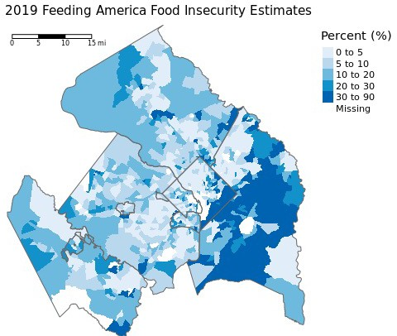
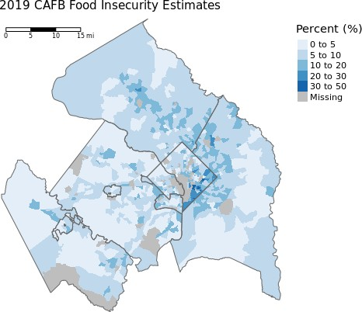
Equity & Stability of Staple Foods Access
Two Measures of Food Insecurity: Feeding America (National – adjusted to Census Tracts) and Capital Area Food Bank (Feeding America Local)

Slide 16
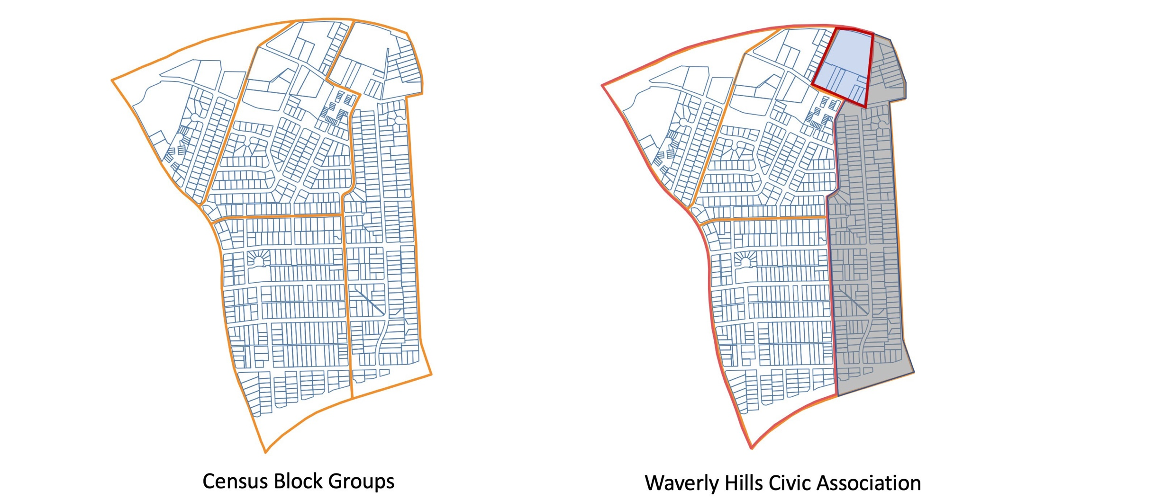
GEOGRAPHIES FOR EQUITY ANALYSIS
Translation of Census Demographics to New Geographies

Slide 17
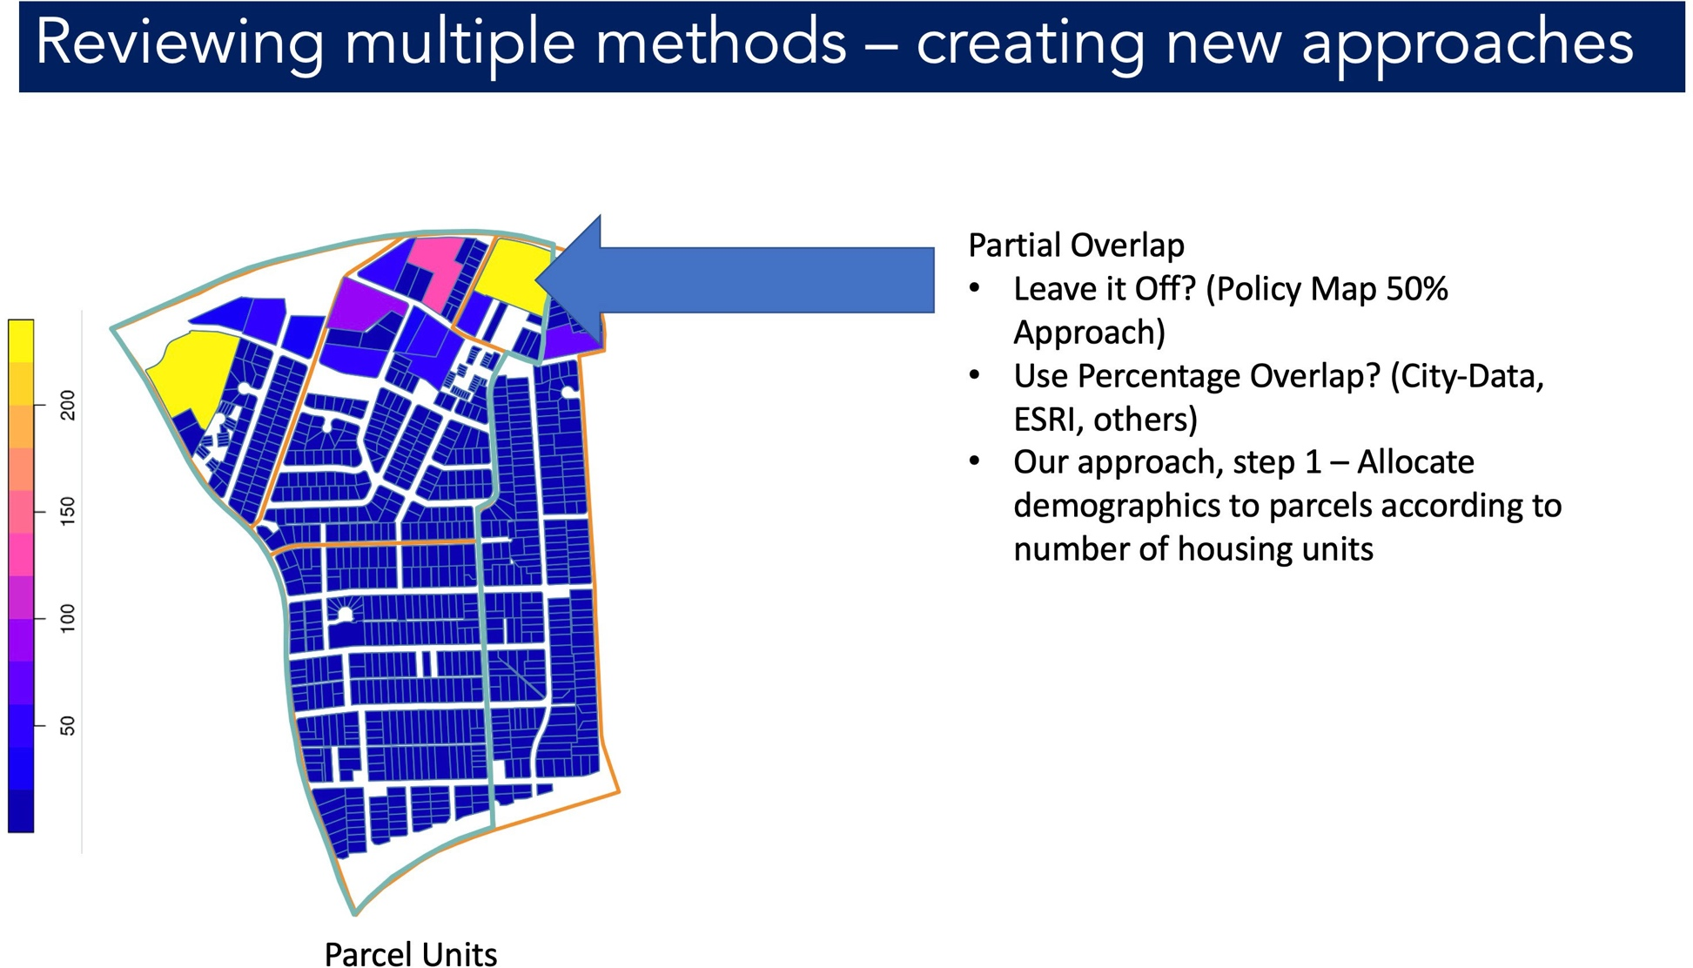
GEOGRAPHIES FOR EQUITY ANALYSIS
Translation of Census Demographics to New Geographies

Slide 18
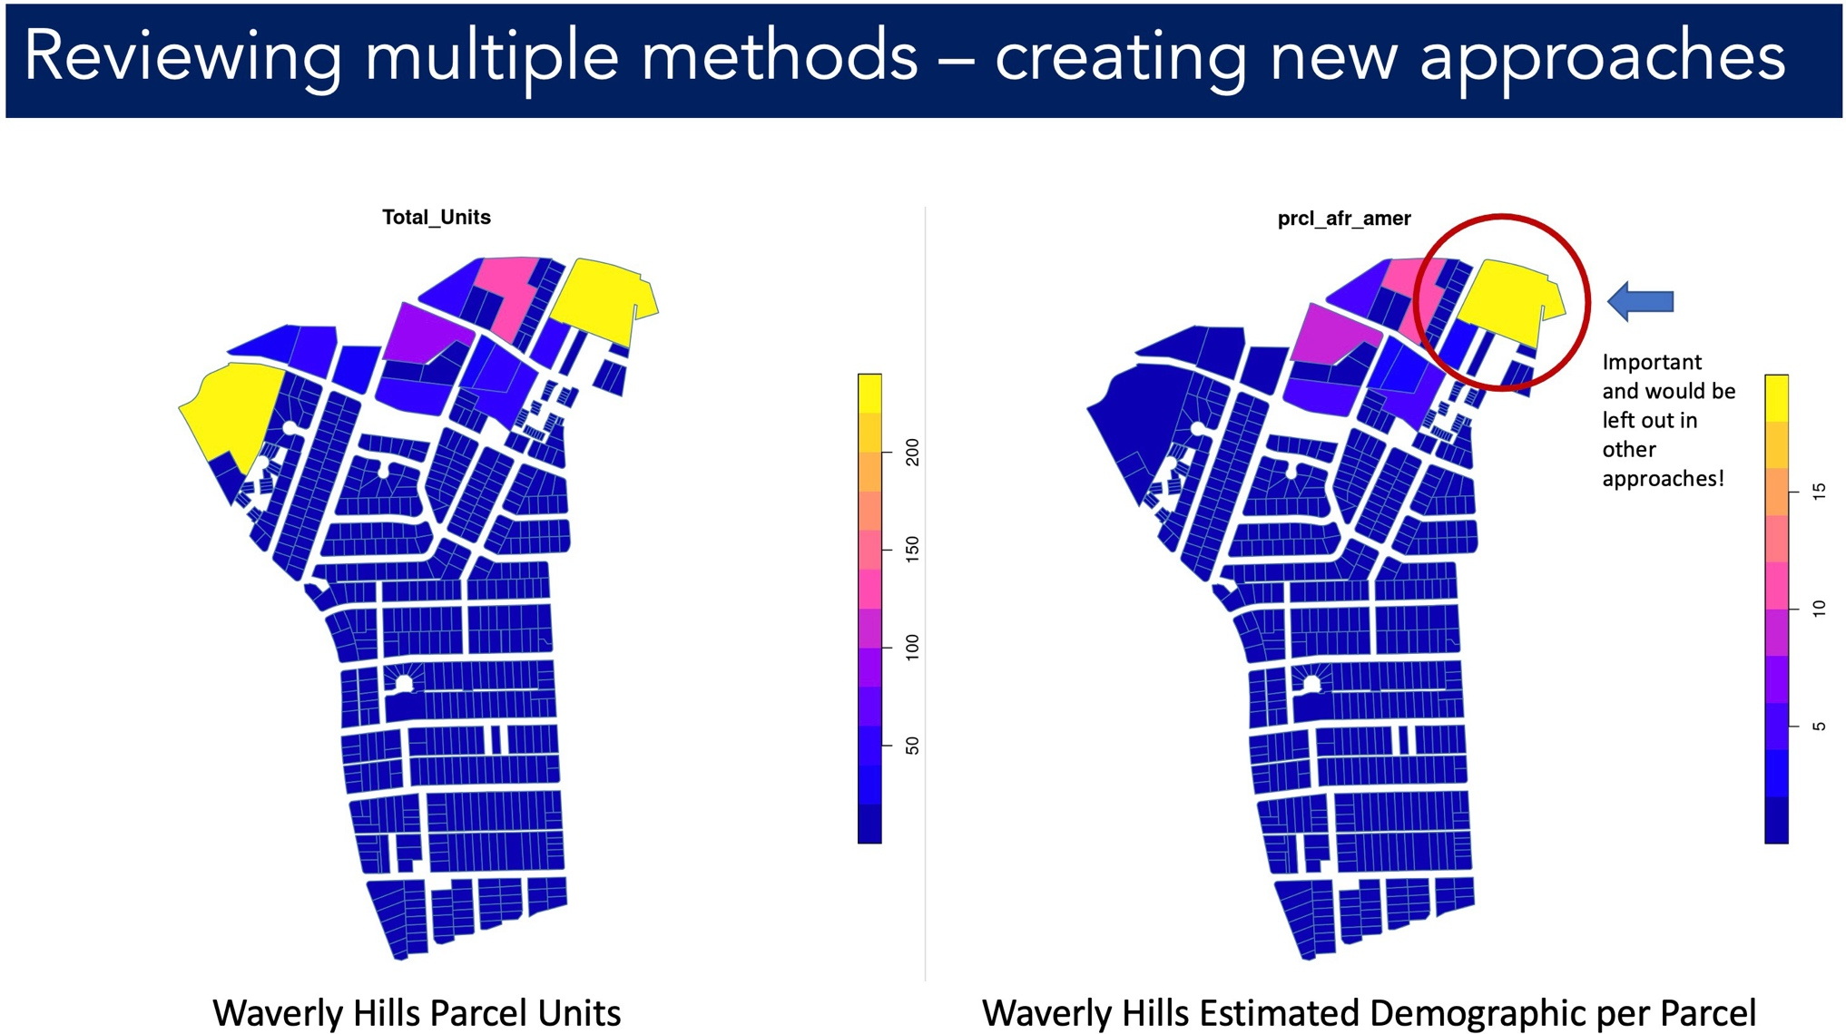
GEOGRAPHIES FOR EQUITY ANALYSIS
Translation of Census Demographics to New Geographies

Slide 19
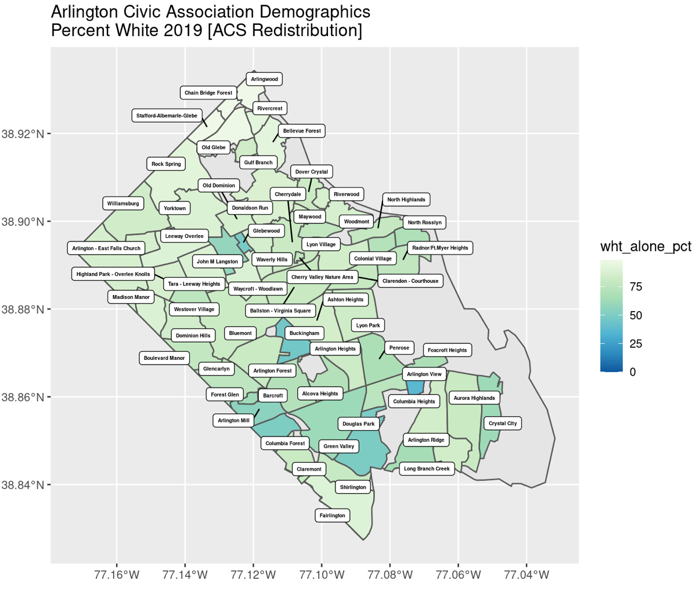
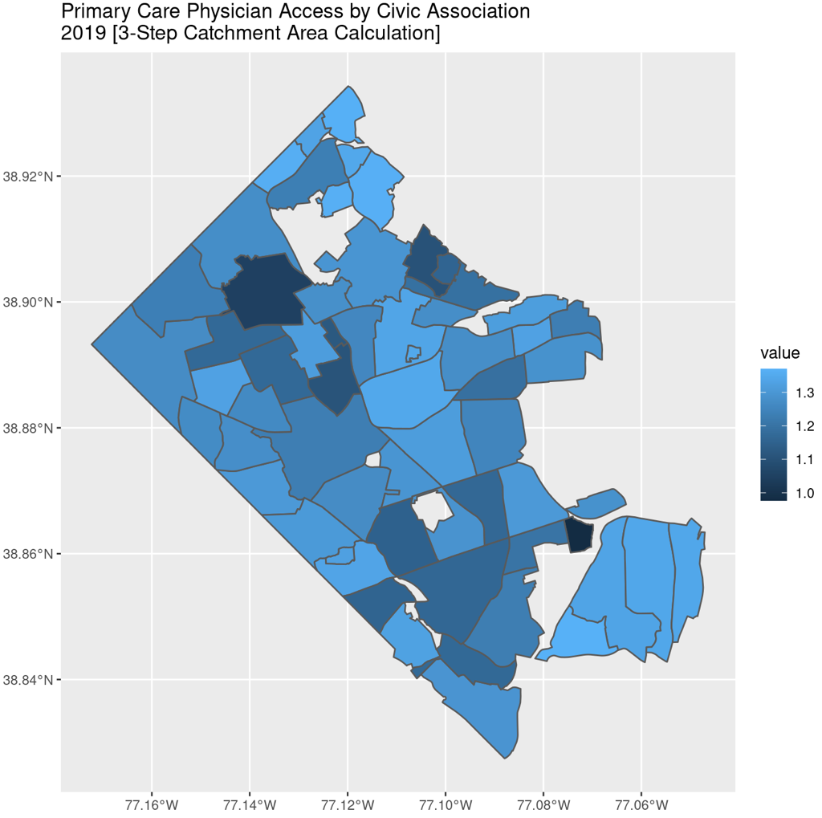
GEOGRAPHIES FOR EQUITY ANALYSIS
ACS Block Group Demographics Translated to Arlington Civic Associations
Need Civic Association Household Income Variable as Well (Coming Soon!)
Census Demographics Redistributed + Relative Primary Care Physician Access (Catchment Area) for Arlington Civic Associations

Slide 20
GEOGRAPHIES FOR EQUITY ANALYSIS
Creating data and metrics in geographies that matter locally
Translation of Census Demographics to New Geographies
Enabling Analysis by Neighborhood, rather than Census Geographies

Slide 21
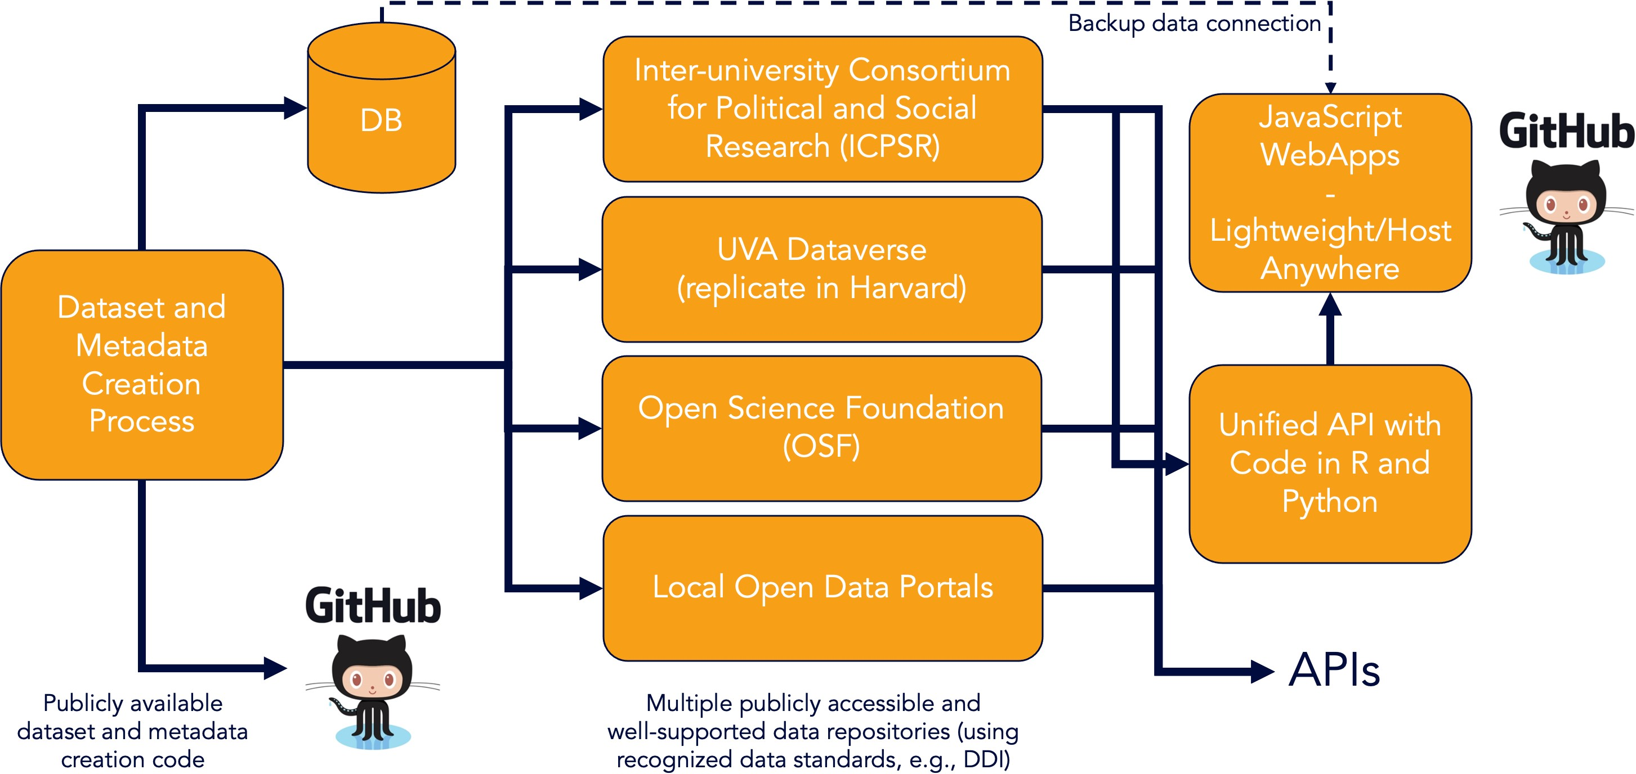
DATA COMMONS GENERALIZED ARCHITECTURE
Modular, Sustainable, Expandable

Slide 22
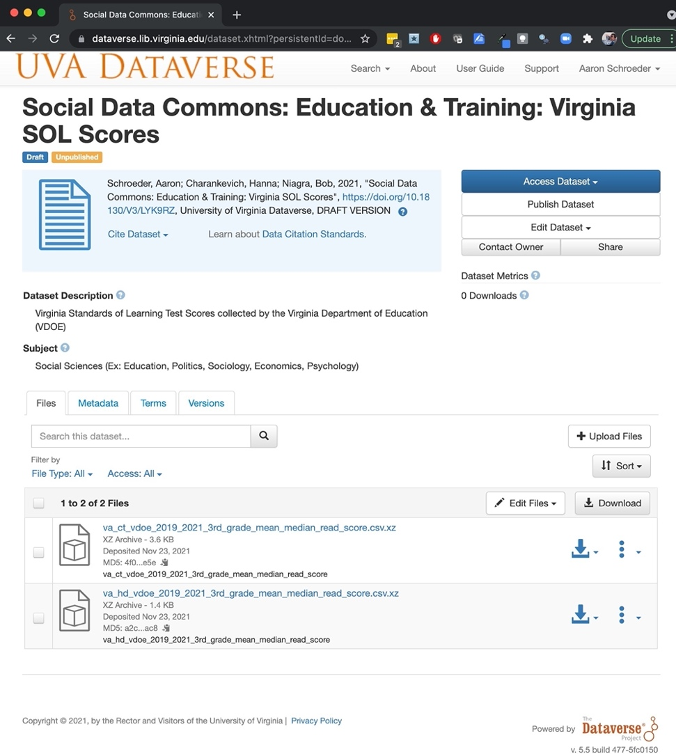
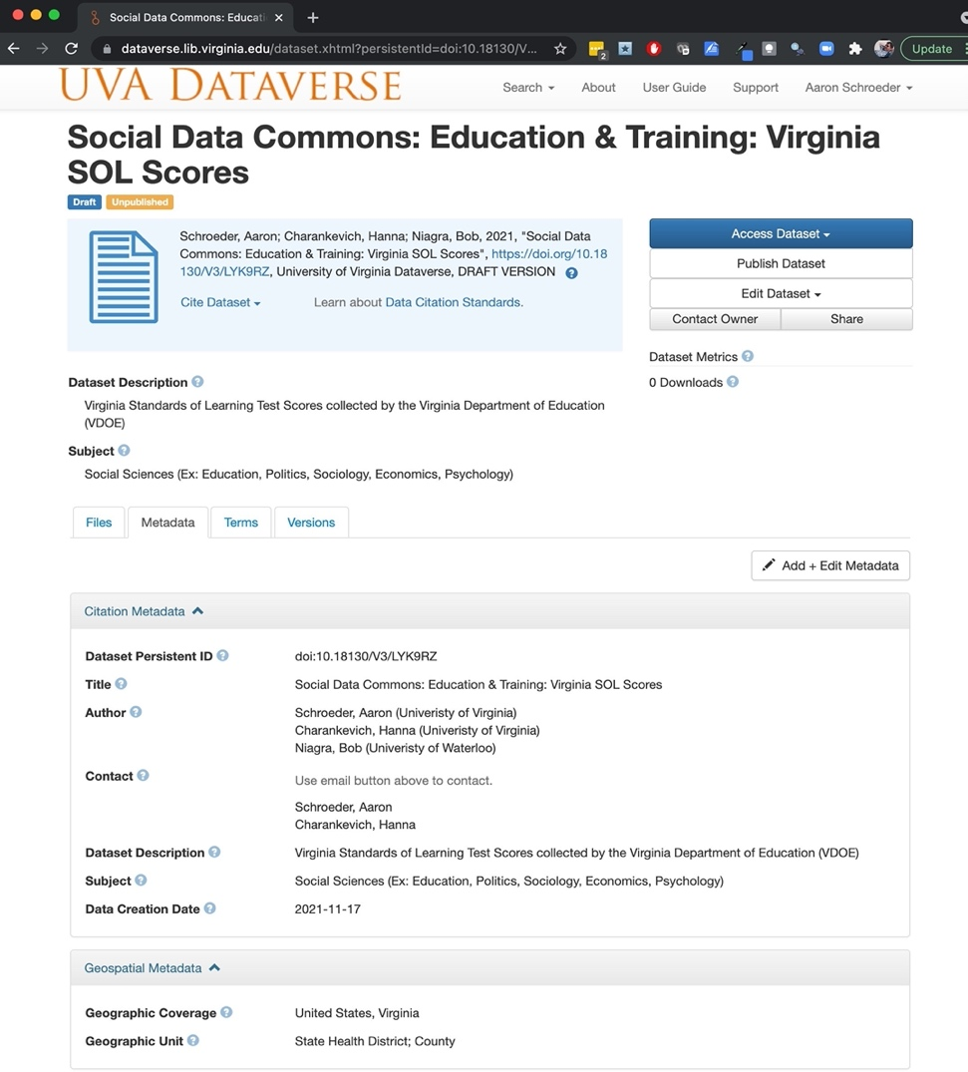
DATA COMMONS GENERALIZED ARCHITECTURE
Dataverse Storage: Leveraging free, well-supported, data and metadata storage and download

Slide 23
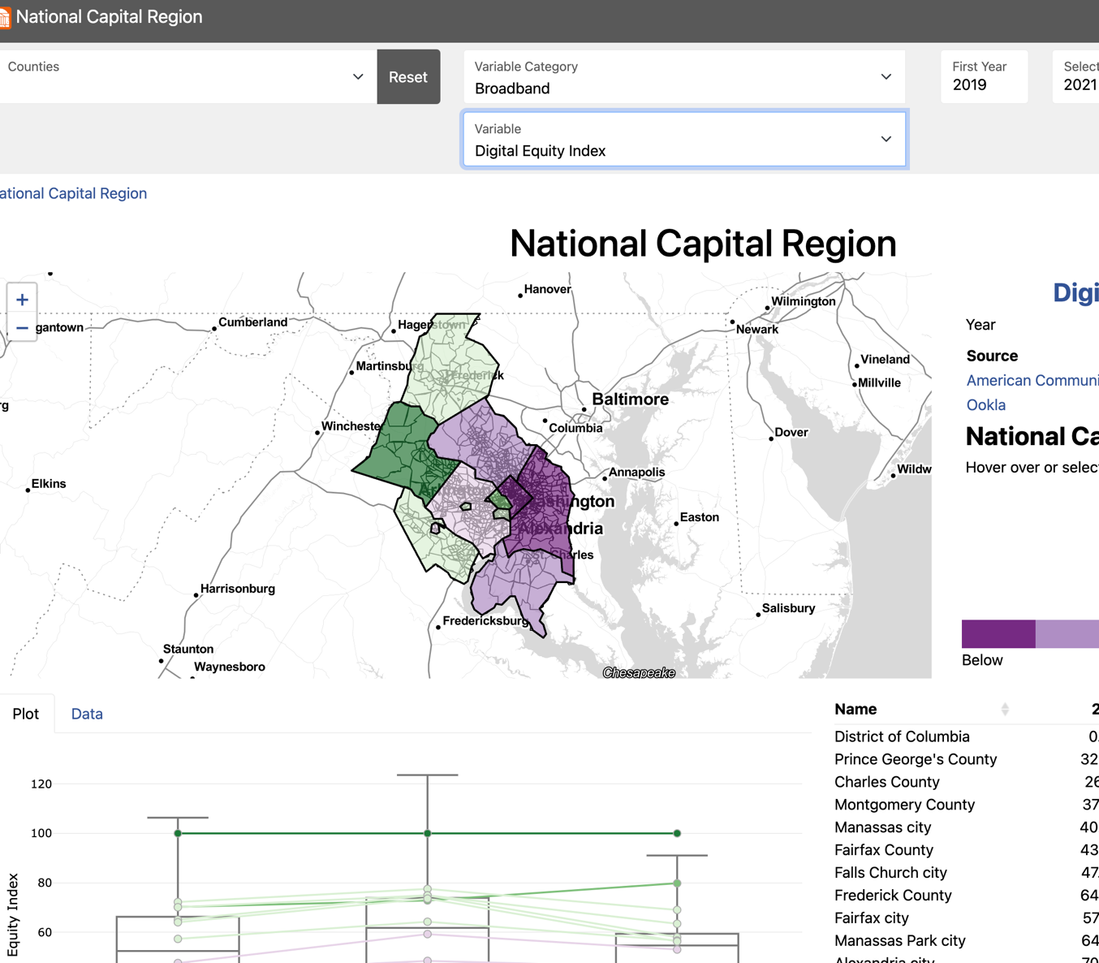
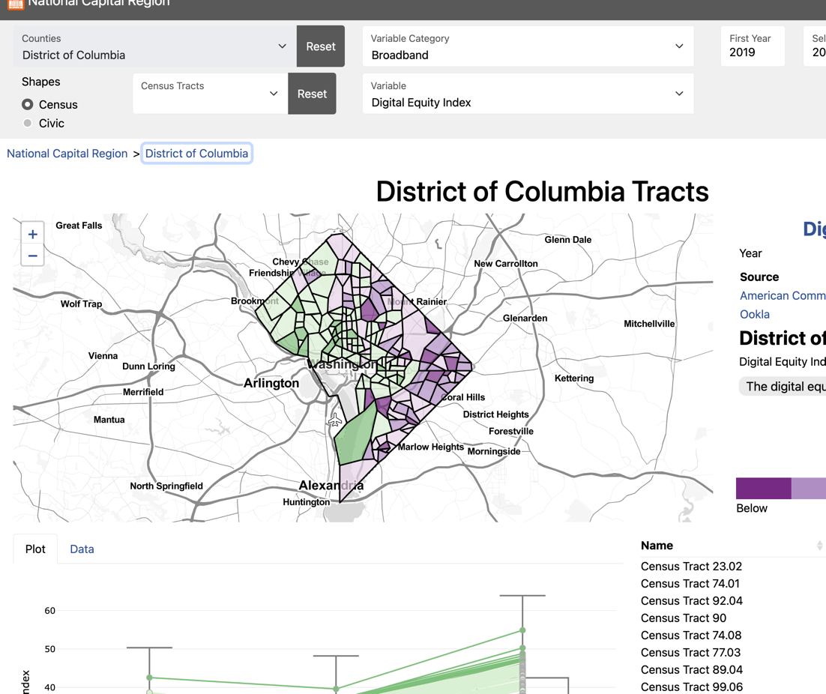
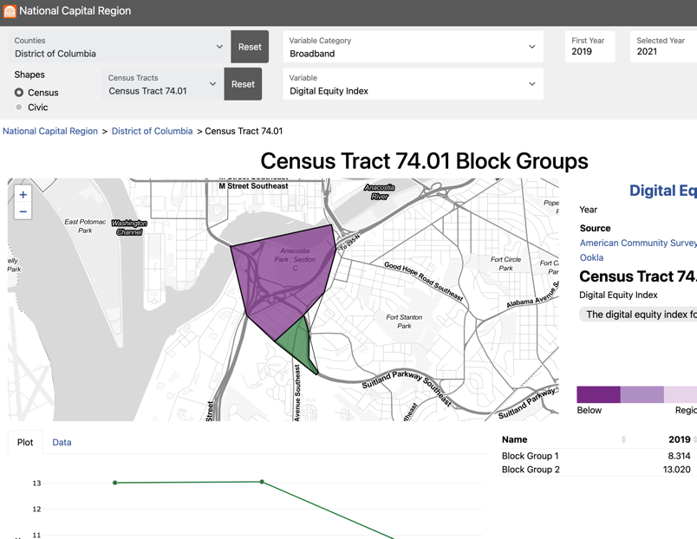
DATA COMMONS GENERALIZED ARCHITECTURE
Lightweight JavaScript WebApp, Universally Deployable: NCR Version (this project: beta): https://uva-bi-sdad.github.io/capital_region/ VDH Version (sister project: deployed, VA only): https://uva-bi-sdad.github.io/vdh_rural_health_site/

Slide 24
NEXT STEP - FAIRFAX POLICY AREA GROUP MEETINGS
Some Ideas from Initial Meetings – Just Getting Started!
Housing Group
Market Affordability Index
Housing Age and Condition Index
Housing Heterogeneity Measure
Neighborhood amenities (transport, food, parks, etc.)
HOA geographies
Food Security Group
Benchmark a “validatable” measure of Food Insecurity
Measuring impact of SNAP on Food Insecurity
Percent of Food Insecure who are eligible for SNAP
Number eligible but not participating in SNAP in multiple geographies
Economic Health & Growth Group
Up-to-date business size and demographics
Measuring the ongoing health of business districts
Understanding migration flows
Planning Unit, COG Traffic Analysis Zone geographies
Technology Group
Broadband access at multiple geographies
Broadband access by demographic groups

